Slide 1
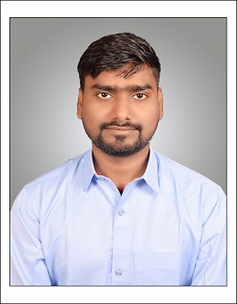
Proficient in Oracle Db Technology having 1.9 year experience in oracle Developer (SQL ,PL/SQL)
Efficient in managing Database using SQL, PL/SQL, Linux ,Unix. Proficient in HTM, CSS, JavaScript.
Seeking a challenging Database engineer role to drive innovation and contribute to success.
●Project/Internship1 : Completed Oracle DB Technology Training with Self made projects and Hands on
●Project/Internship2 : Completed Mean Stack Technology with Angular Framework Training
with Self made Projects and Hands on
Project Worked On -: NVS_AMS_DT_Shared_Alloc as a Architecture Platform and Data.
TECHNICAL TRAINING DETAILS
HTML5, CSS3, Javascript :- (User Interface Design ,Created Web and Jsp Pages).
BASIC JAVA:- (Java Programming , Practice Case Study)
ANSI SQL :- ( SQL Programming ,Modeling and manipulating data.)
PL SQL :- (Programming and manipulating Data)
Certification:- Oracle Cloud Data Management Foundations Associate, Oracle Cloud Infrastructre Foundation Associate
I
Lakshman Kumar
Programmer Analyst
MEAN STACK
ORACLE DB
Javascripts
Oracle Forms
Python
Oracle Apex
HTML
CSS3
Oracle Sql
Bachelor Of Technology (Electrical Engineering).
lakshman.kumar3@cognizant.com

